Slide 1
Unit 3
Image Restoration and Reconstruction

Slide 2
Image Restoration: Recover an image that has been degraded
Restoration is done by using prior knowledge of the degradation phenomenon
Model the degradation process and apply the inverse of that model to restore the image
Can be done in spatial domain as well as frequency domain

Slide 3
Model of the image restoration process
f(x,y) is processed with a degradation function H and noise term to produce the degraded image g(x,y)
Restoration: Given g(x,y), some knowledge about H the noise term and some knowledge about the additive noise, obtain an estimate f’(x,y) of the original image
More we know about H and noise more close approximation of the original image can be obtained

Slide 4
Degraded image in spatial domain is given as
Convolution of h(x,y) and f(x,y)
In frequency domain
Multiplication of H(u,v) and F(u,v)

Slide 5
Noise models:
Noise Arises during the acquisition and/or transmission
While acquiring with CCD cameras, light level and sensor temperatures affects the amount of noise in the image
During transmission by interference in the transmission channel
Image transmitted by wireless medium can be affected by lightning or other atmospheric disturbance
Noise component is an image is of the same size of the input image

Slide 6
Types of noise
Gaussian noise
Rayleigh noise
Gamma noise
Exponential noise
Uniform noise
Salt and pepper (impulse) noise

Slide 7
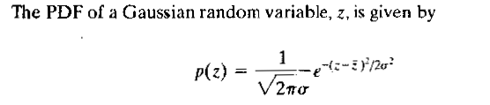
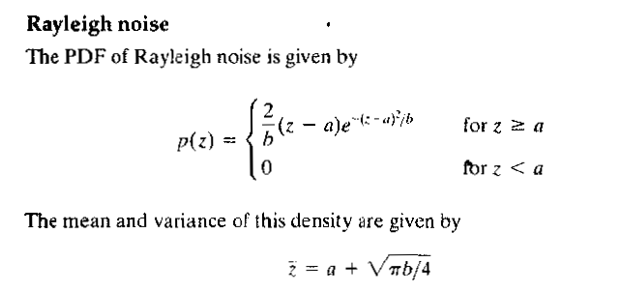

Gaussian Noise
Rayleigh Noise

Slide 8
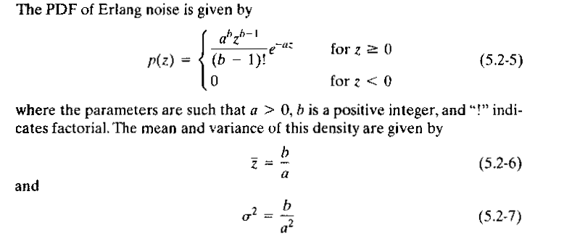
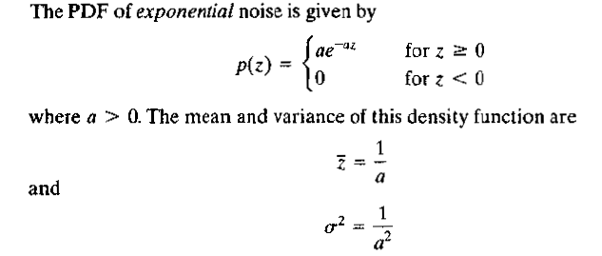
Erlang(Gamma noise)
Exponential Noise

Slide 9
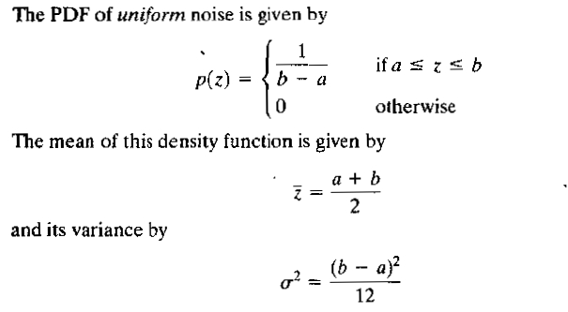
Uniform Noise
Impulse (Salt and Pepper noise)

Slide 10
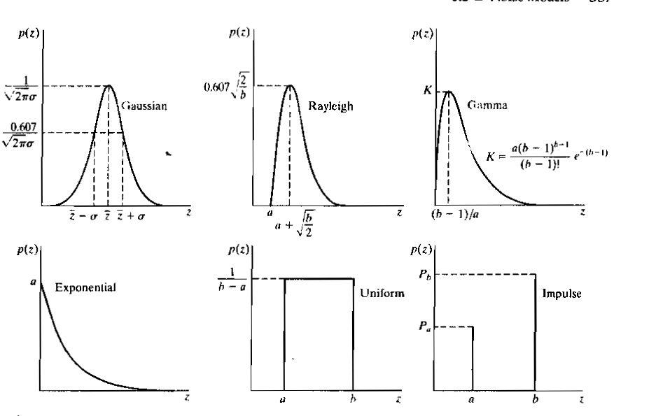

Slide 14
Estimating the noise parameters
Method 1: Observation of the image in the Fourier spectrum.
Noise will form frequency spikes.
Gaussian noise

Slide 15
Salt and Pepper
Gaussian

Slide 16
Salt and Pepper noise
Salt and Pepper Noise: Salt and Pepper noise is added to an image by addition of both random bright (with 255 pixel value) and random dark (with 0 pixel value) all over the image

Slide 17
Fourier Transform
Gaussian
Salt and Pepper

Slide 18
Histograms of images after adding noise

Slide 19
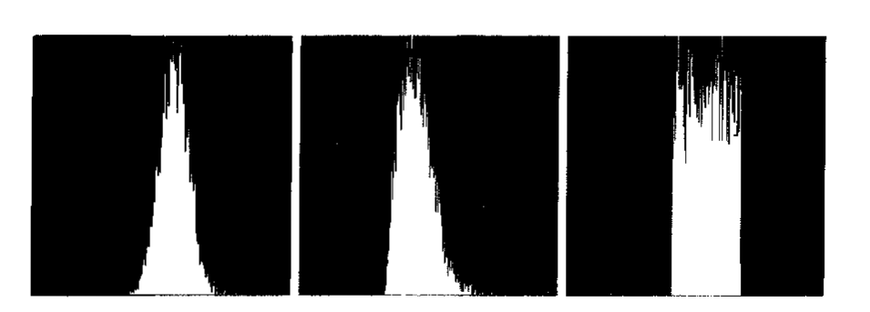
Small image strips of size 150 x 20 pixels cropped

Slide 20
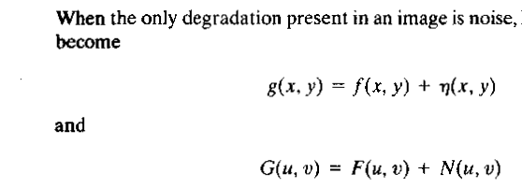
Noise reduction
How to use spatial filters for noise reduction ?

Slide 21
Mean filters
Arithmetic mean filter
Computes the average value of the corrupted image in the small sub region s considered
Geometric mean filter
Harmonic mean filter

Slide 22
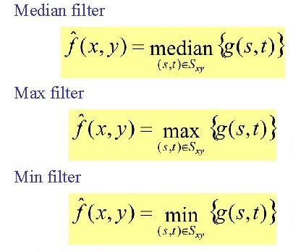
Order Statistics filters

Slide 24
d ranges from 0 to = mn-1
When d=0, it becomes and average filter
When d=mn-1, it becomes a median filter
Useful in case of a combination of Gaussian and salt and pepper noise

Slide 25
Mean filter blurs the image
Median filter removes noise without blurring the image
Median filter is good when salt and pepper is present.
Max filter is good for pepper noise
Min filter is good for salt noise.

Slide 26
Removal of Salt and Pepper noise
Removal of Gaussian noise

